Slide 1


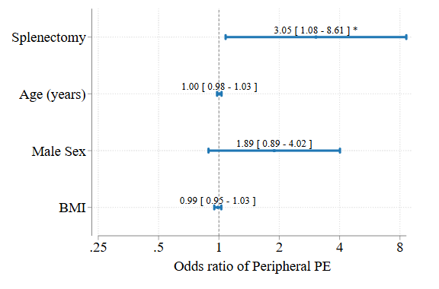
Pulmonary Embolism location following splenectomy: a potential model for CTEPH development.
Darren White, MD (1). Mark Dodson, MD (2). Brian Locke, MD (2). Kaan Raif, MD (3).
University of Utah Division of Respiratory, Critical Care, and Occupational Pulmonary Medicine
Intermountain Medical Center Division of Pulmonology and Critical Care
University of Utah Division of Internal Medicine
Rationale
A link between splenectomy and Chronic Thrombembolic Pulmonary Hypertension (CTEPH) has been reported.
The risk of CTEPH in splenectomy patients is higher than would be explained by increased VTE risk alone.
Understanding clot location and clot burden may allow further insights into the mechanism by which patients develop CTEPH.
Methods
Retrospective review of CT imaging from patients with splenectomy and PE vs control group with PE and no splenectomy.
Two physicians independently analyzed clot burden based on the Qanadli index and characterized PE as peripheral or central.
Patients admitted for PE in two Utah Hospitals between 2003 and 2020.
Logistic regression to evaluate odds ratio for central PE
Secondary data points compared with Wilcoxon Rank-sum for continuous measures and Chi-Square for categorical measures.
Central vs Peripheral PE in Splenectomy vs all PE patients
Results
No difference in Qanadli score between the groups, high agreement between authors (Kappa 0.71)
Patients with PE and splenectomy more likely to have duration of symptoms > 2 weeks (p 0.044) and less likely to have DVT found during their workup (p 0.002).
Discussion
PE following splenectomy occurs in a more peripheral distribution than PE in all comers.
Overall clot burden and signs of RV strain not different suggesting not playing a role in CTEPH development.
CTEPH association with splenectomy may be due to:
recurrent small volume venous thromboembolism
clot in locations other than lower extremities
in situ thrombosis of the pulmonary artery
Limitations
Retrospective Review
Unblinded as spleen visible on CT images
Single center only
Splenectomy patients have higher odds of peripheral PE compared with patients who have not had splenectomy.
Key clinical characteristics of patients
 | No Splenectomy | Splenectomy | p-value
N | 100 | 40
Age at index PE | 61 (52,73) | 56 (41,66) | 0.013
Male Sex | 48% (48) | 35% (14) | 0.16
PE severity index (PESI) | 97 (75,120) | 89 (66,111) | 0.097
PA Enlargement (CT) | 71% (71) | 68% (27) | 0.68
RV to LV ratio (CT) | 1.07 (0.88,1.31) | 1.07 (0.94,1.35) | 0.31
RV to LV ratio abnormal (>1 by CT) | 55% (55) | 70% (28) | 0.10
Troponin (max) (ng/mL) | 0.01 (0.01,0.08) | 0.01 (0.01,0.03) | 0.067
BNP (max) (pg/mL) | 62 (18,306) | 49 (24,110) | 0.70
Peripheral PE | 37% (37) | 52% (21) | 0.093
Qanadli Score (Avg) | 0.22 (0.08,0.48) | 0.13 (0.06,0.34) | 0.32
Duration of Symptoms ≥ 2 weeks | 8% (8) | 20% (8) | 0.044
DVT found within 2 weeks | 71% (48) | 35% (8) | 0.002
Splenectomy patients are yopunger, more likely to have >2 weeks of symptoms, less likely to have DVT found within 2 weeks of PE.

